Slide 1
Embedded C program for interfacing 16X2 LCD with STM32

Slide 2
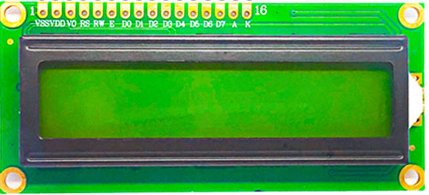
16X2 LCD Pinout

Slide 3
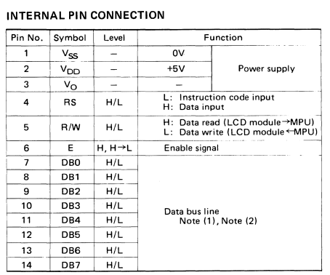
Delving into datasheet

Slide 4
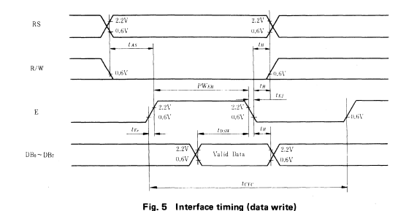
Steps to send command or data to LCD
Load the command or data onto the DB0~DB7.
Make register select(RS) to “low” for command and “high” for data.
Send a pulse on the enable pin with pulse width of 5-6ms.

Slide 5
Steps for initializing LCD
Set the LCD TO 5X8 mode (5 columns 8 rows)
Send a command to display the cursor
Set the cursor to auto increment mode, so that as we write data the cursor moves with the data
Clear the display.
Set the register value to 0x80 (1st row 1st column)

Slide 6
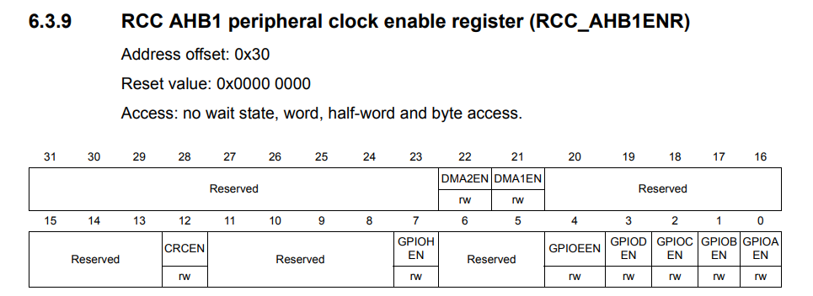
Enabling Clock
RCC->AHB1ENR = 1;
Let us use GPIOA for all the operations.

Slide 7
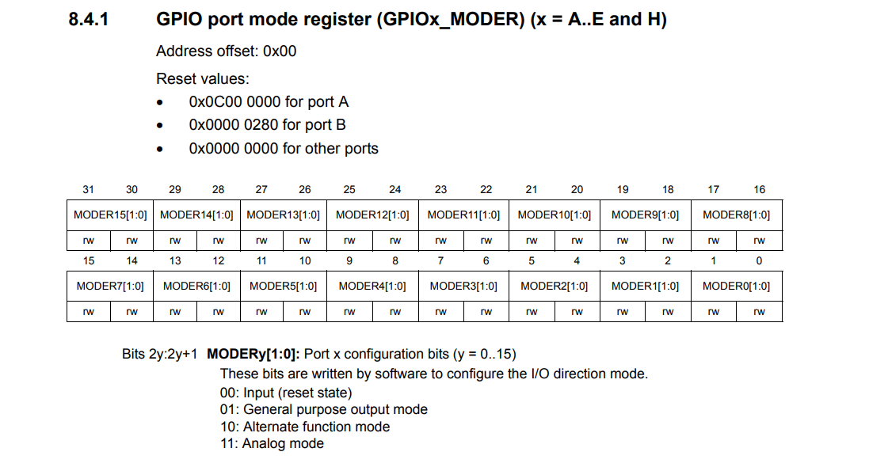

Slide 8
How to Write a value into a register?
GPIOA->MODER = 0X00000001; //which means PA.0 is output
Now if I want PA.3 to be as output then
GPIOA->MODER = 0X00000040;
This will configure PA.3 as output but remove the previous configuration of PA.0.
Instead we can use “&=~” combination read as “and assigned with negation of” to reset particular bits.
We can use “|=“ combination read as “or assigned with” to set particular bits.

Slide 9
How to Write a value into a register?
Objective: make PA.0, PA.1 and PA.8 to PA.15 as outputs.
Steps:
Reset the MODER register of port B pertaining to PB.0 to PB.6 and PB.12 to PB.15
A moder state of “00” for a particular pin is assumed to be the reset state.
GPIOA->MODER&=~0XFFFF000F;
Configure the MODER register of port B for PB.0 to PB.3, PB.12 to PB.15 as outputs and PB.4 to PB.6 as inputs
“01” for a pin is treated as output.
“00” for a pin is treated as input.
GPIOA->MODER|=0X55550005;

Slide 10
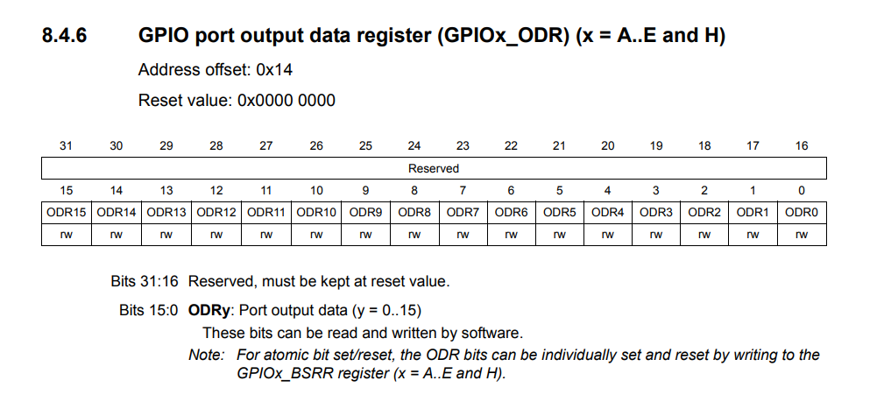
Configuring ODR

Slide 11
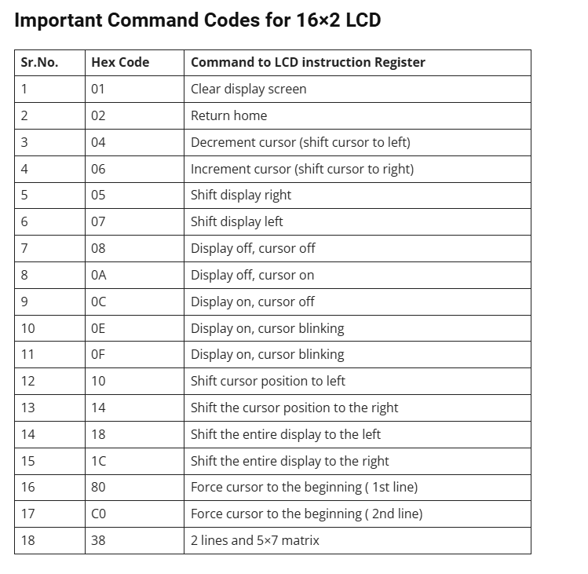

Slide 12
Developing LCD Driver functions
lcdprint(ch)
Left shift the data by 8 bits
Send pulse on enable pin
Make RS high to say its data
Load the data
sendcmd(ch)
Left shift the data by 8 bits
Load the data
Make RS low to say its cmd
Send pulse on enable pin
lcdinit()
Send initialisation commands
sendcmd(0x38);//16 column 2 row mode
sendcmd(0x0F);//display on cursor blinking
sendcmd(0x06);//auto increment
sendcmd(0x01);//clear display
printstr(*ch)
Loop till the string ends
Print the string
Character by character

Slide 13
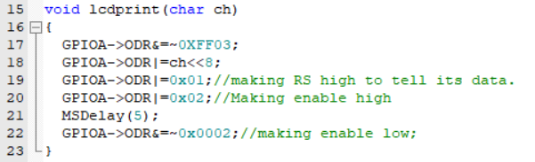
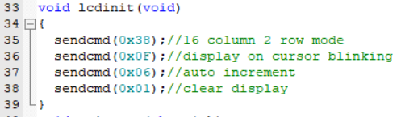
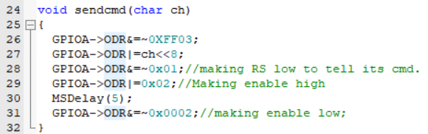
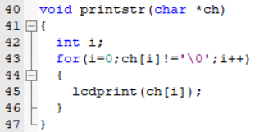
Driver function codes
Displaying a character function
Lcd initialisation function
Sending a command function
Printing a string function

Slide 14
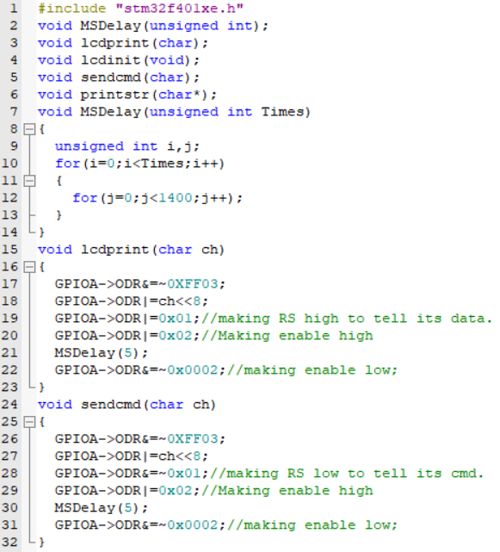
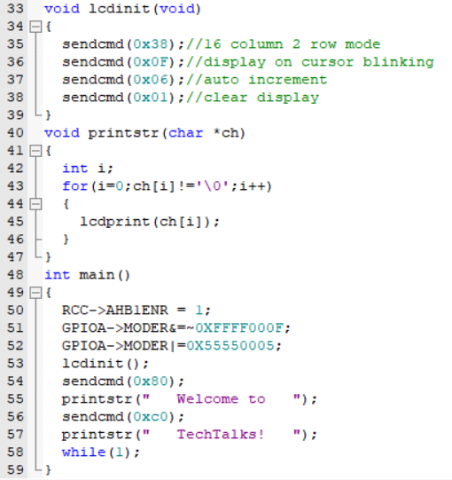
Final Code

Slide 15

Please Subscribe to my channel……..
Like Share Comment Subscribe

